Slide 1
48v Cryo Board to Cryo Cooler
v2 (2026)

Slide 2
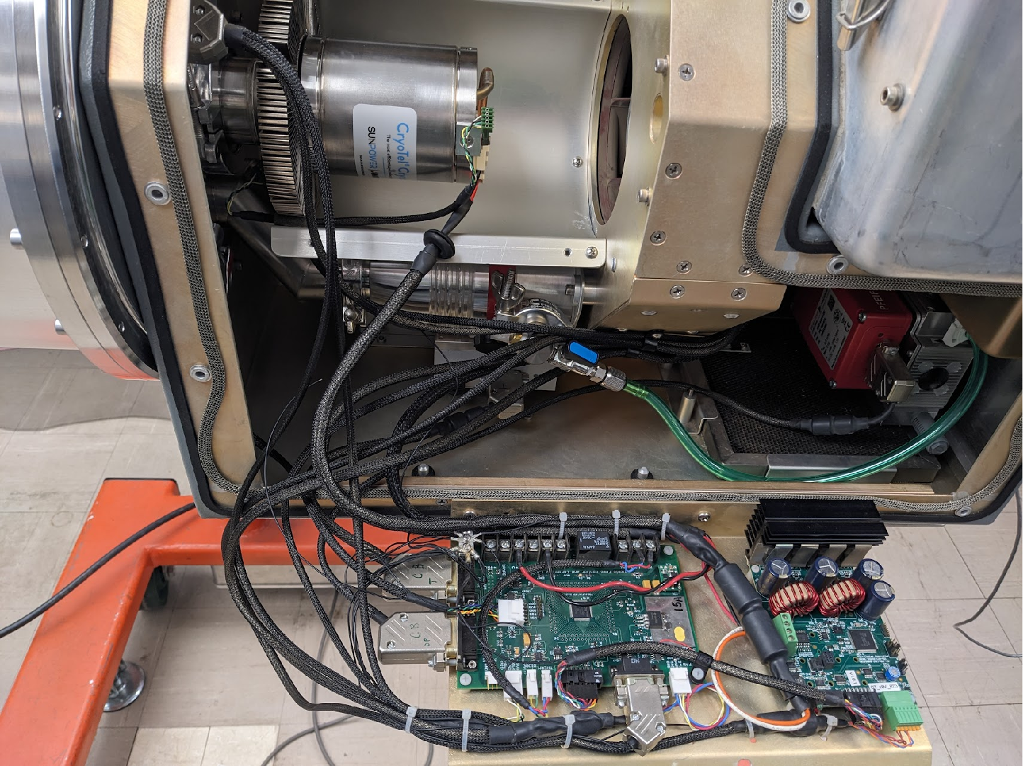
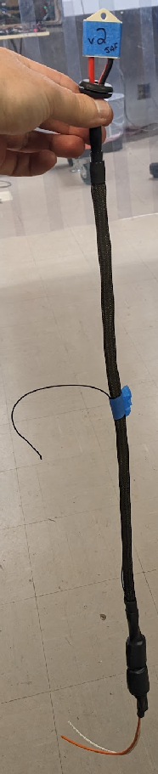
Purpose
Power cable, needs lengthening and shielding for installation in a feed.
Connects the cryo cooler to a 48V supply board.

Slide 3
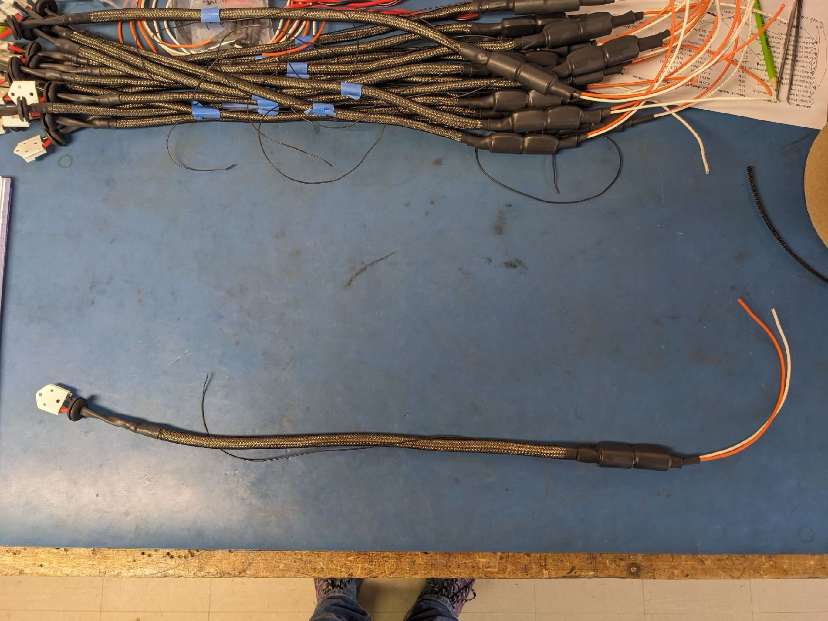
Schematic
These dimensions are approximate. Tolerances of up to 0.5in are acceptable.
plug
ground wire
grommet
extensions
shielding (plastic over metal)
magnets
2in
17in

Slide 4
Outline of steps
(see later slides for detailed instructions and images)
Remove original wire harness from power cable
Form a twisted pair
Install a rubber grommet to be used as a spacer near the plug
Install wire extensions
Install metal braided shielding below the plug
Solder a ground wire to the metal shielding
Install plastic braided shielding to cover the metal shielding and the ground wire solder joint
Install magnets below the shielded portion of the cable

Slide 5
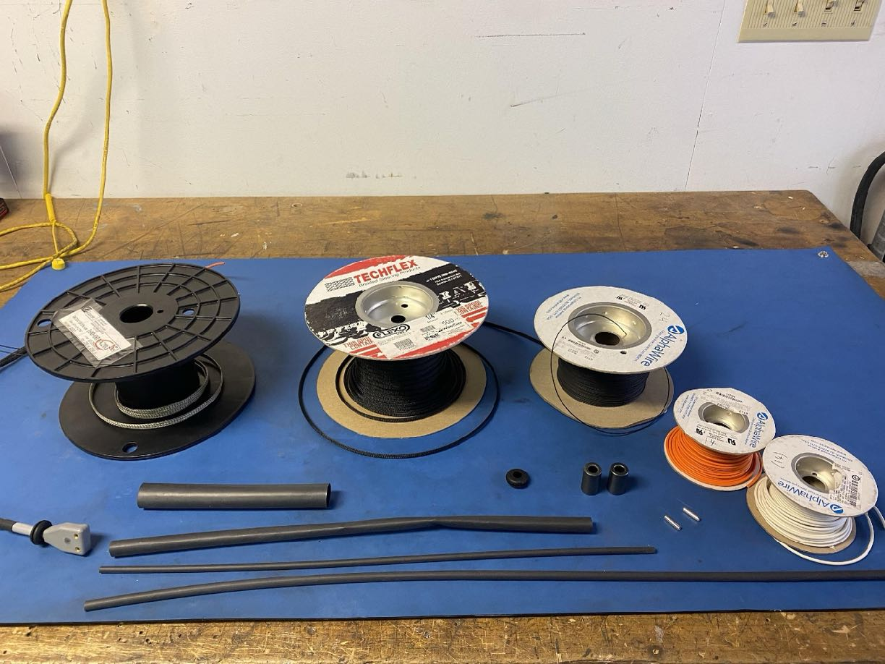
Materials

Slide 6
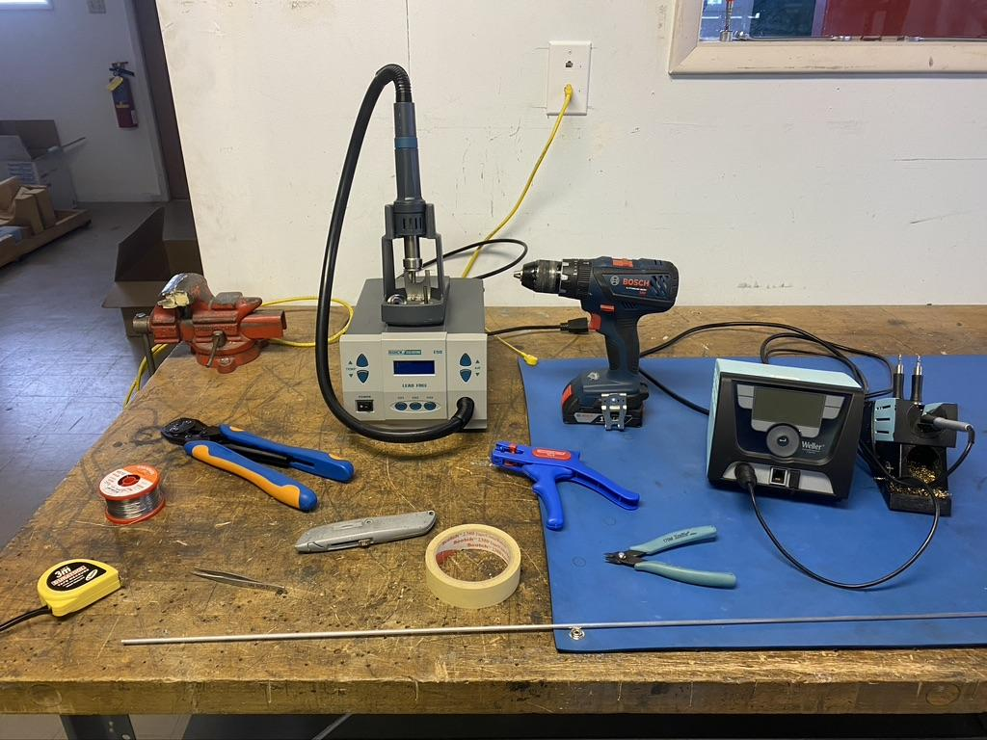
Tools

Slide 7
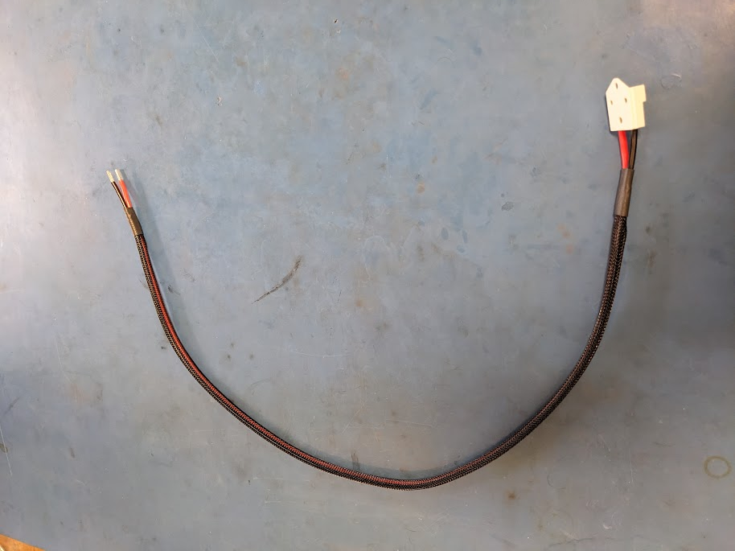
The power cord that comes with each cryocooler appears as shown. For our purposes, it needs to be retrofitted.

Slide 8
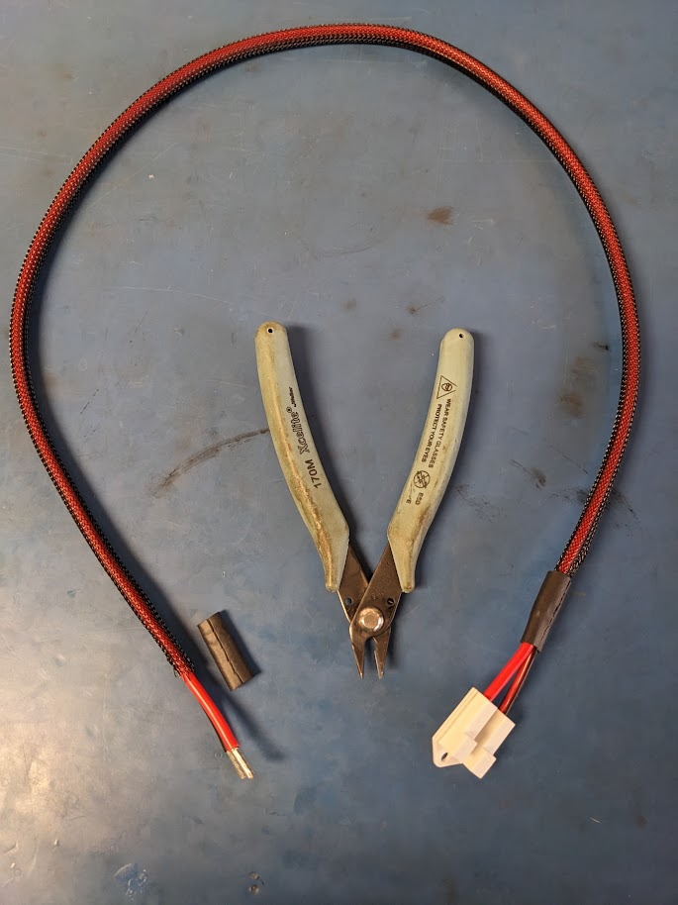
Cut the ferrules off the harness. Cut away the shrink tube on both ends of the harness and slide the plastic shielding off.

Slide 9
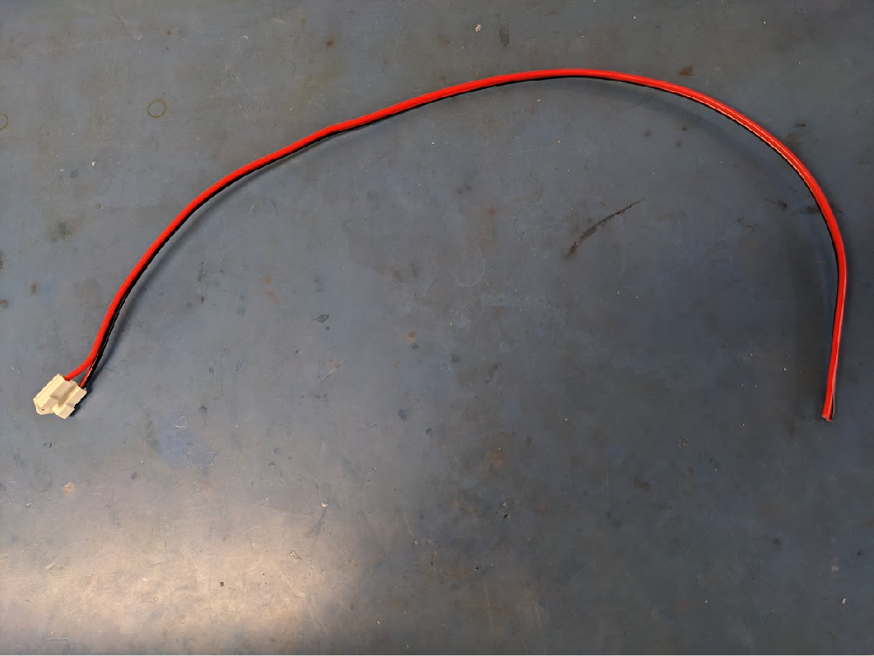
The wire harness has two untwisted wires adhered together, as pictured below.
For our purposes, we will need to make the wires a twisted pair.

Slide 10
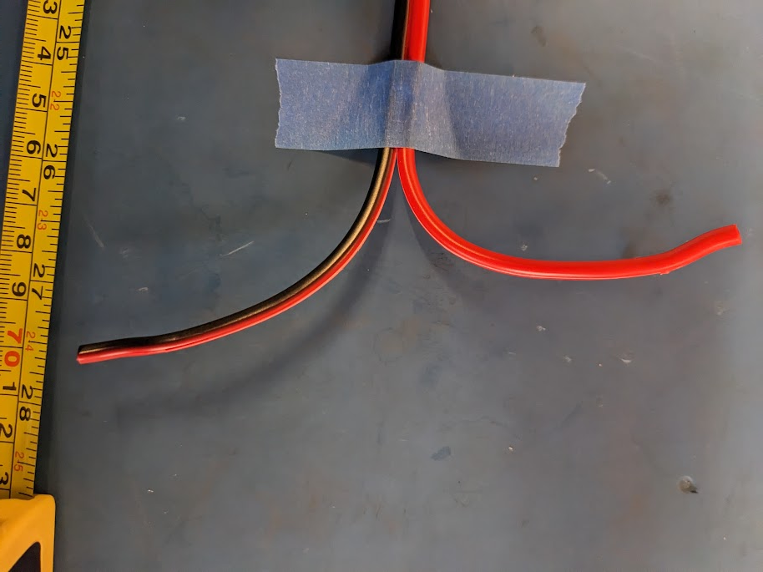
Gently pull the wires apart to separate them. They should come apart cleanly.

Slide 11
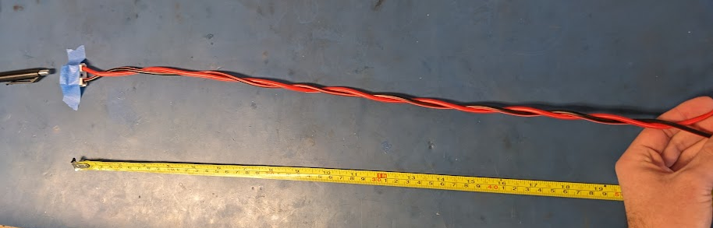
Fasten the plug-end to the workbench with tape. Starting at the plug-end and working your way down, hand-twist the wires together.

Slide 12
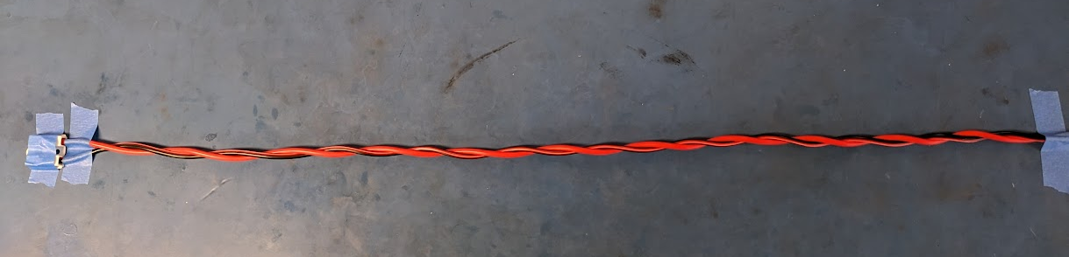
Fasten the other end to the workbench. Leave it twisted and fastened at both ends for at least 10 minutes so that the wires do not immediately untwist when you work with them in future steps.

Slide 13
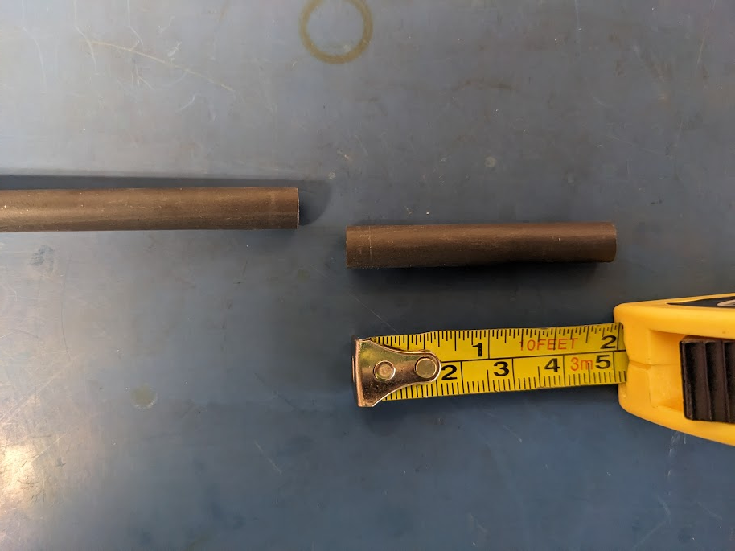
Measure out and cut one length of 6.4mm adhesive shrink tube 2in long.

Slide 14
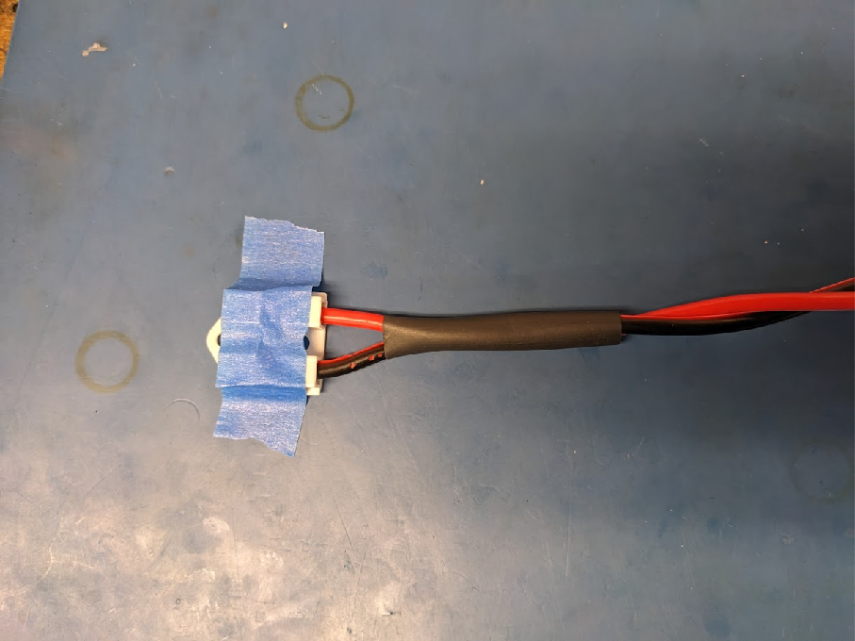
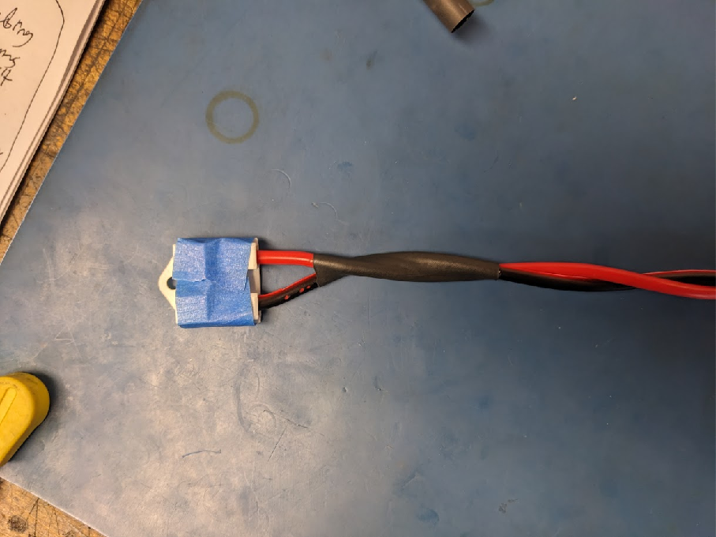
Place the shrink tube over the twisted pair of wires as near as possible to the plug.
Apply the heat gun to seal the shrink tube in place.

Slide 15
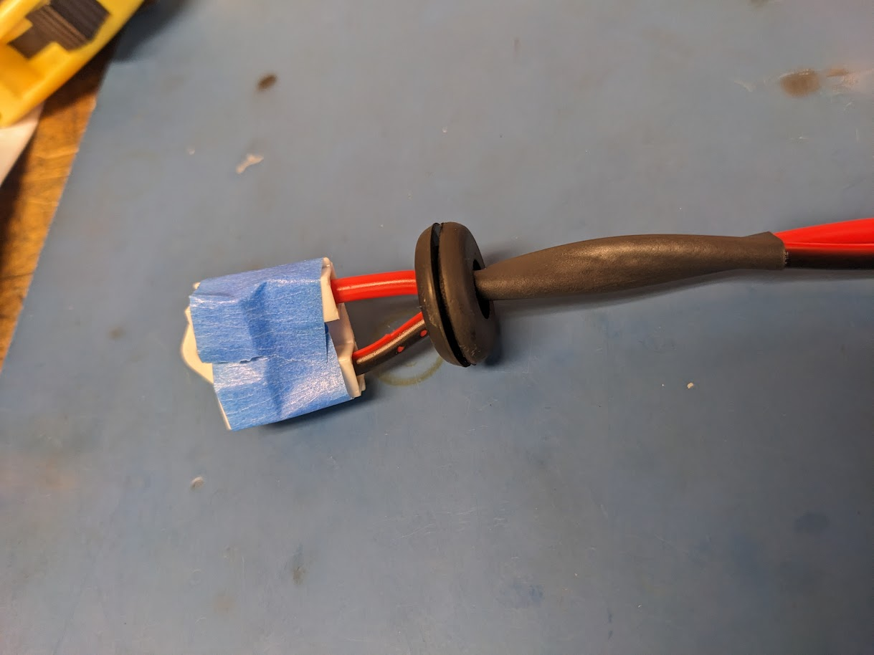
Thread the cables through a 5/8 in. rubber grommet so that the grommet rests on the 2in length of shrink tube.

Slide 16
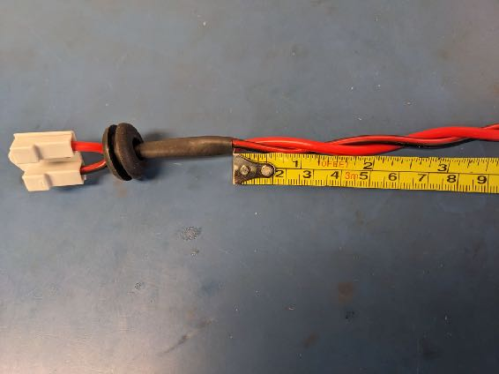
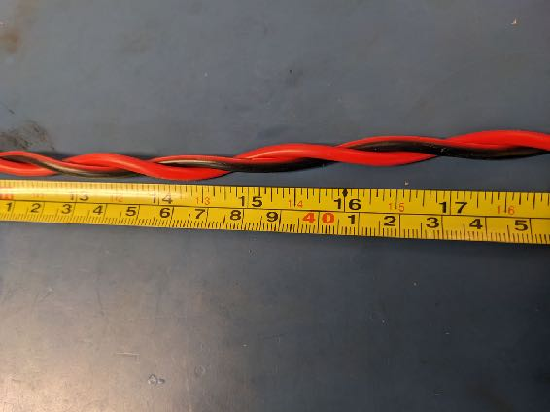
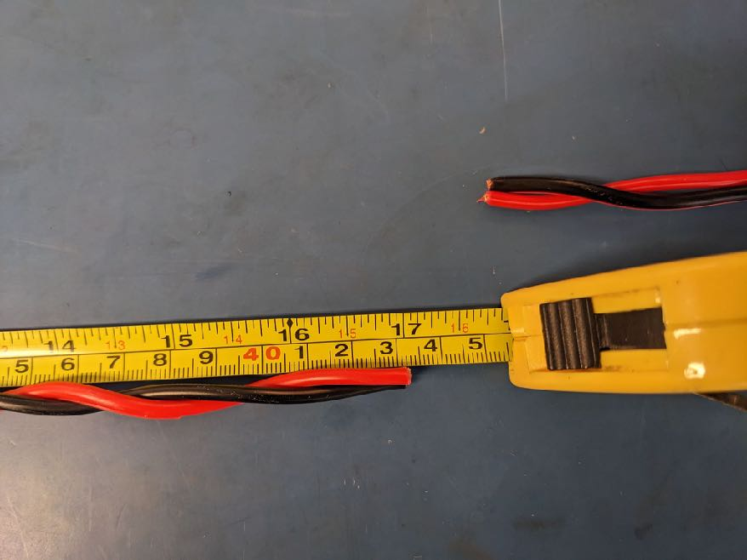
Measuring from the bottom end of the heatshrink tubing as pictured below, trim the twisted pair at 17in.

Slide 17
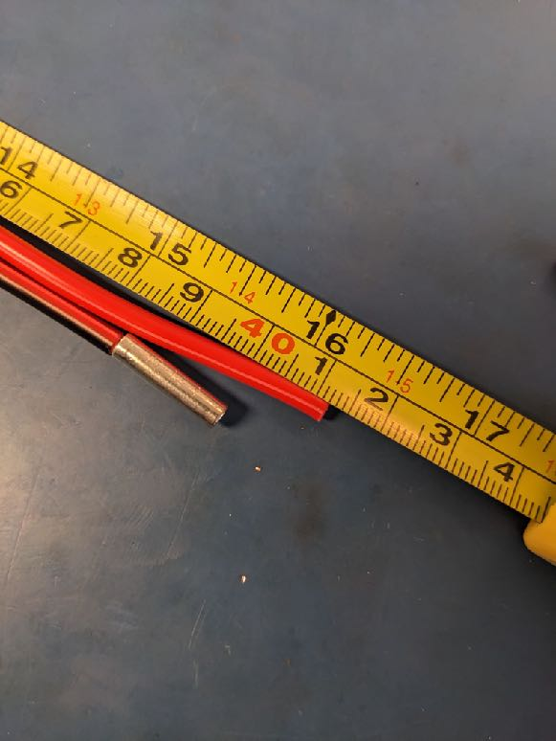
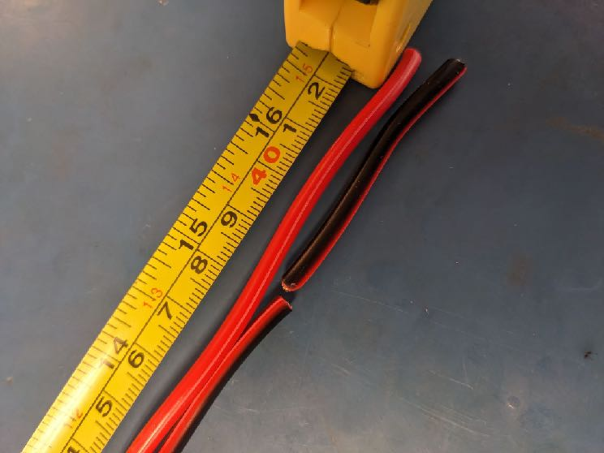
Measuring from the bottom end of the heatshrink tubing again, cut the black wire at 15in. Cut the red wire at 16.5in.

Slide 18
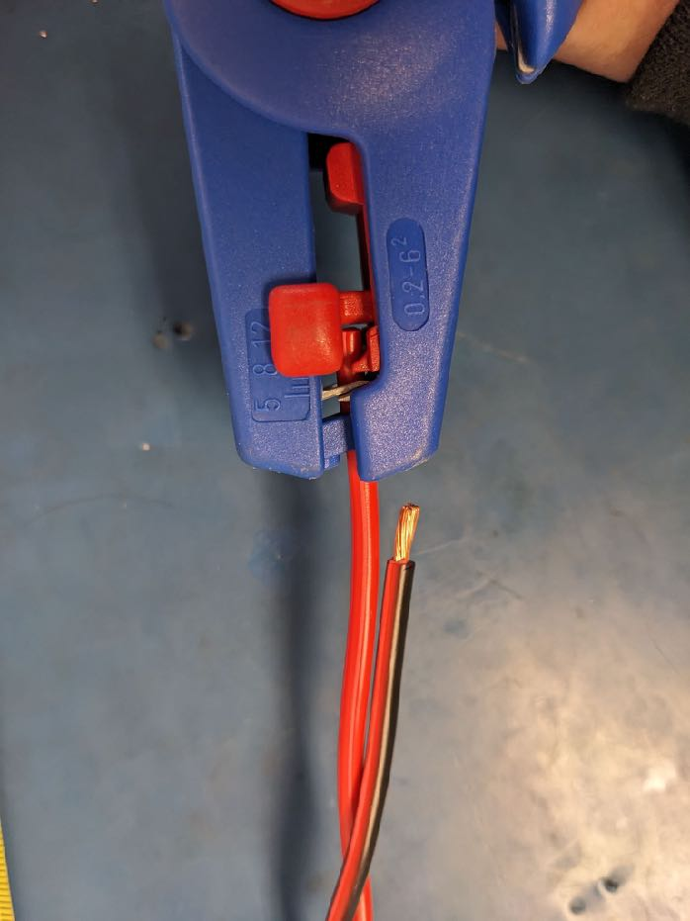
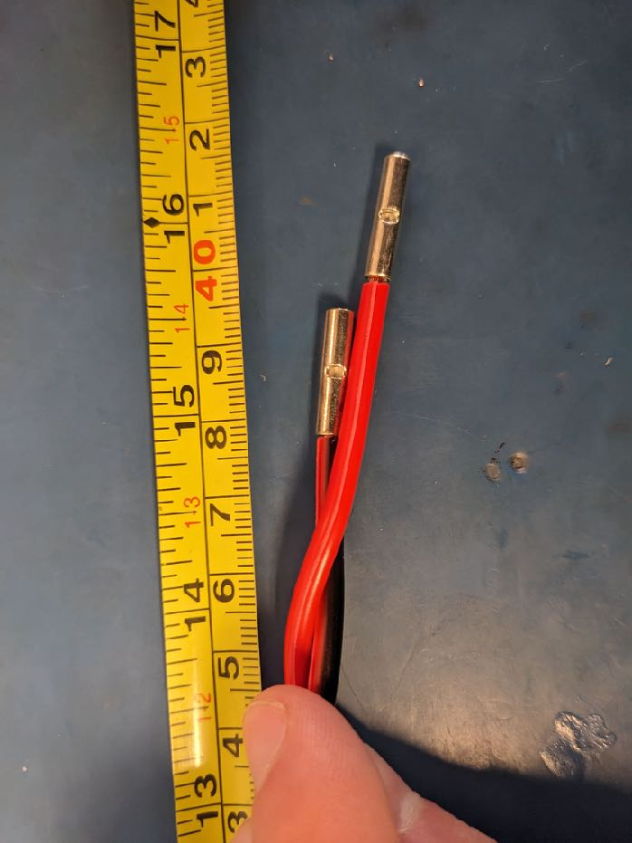
Strip 6-7mm of isolation from the recently-cut ends. Place terminals on the bare wire.

Slide 19
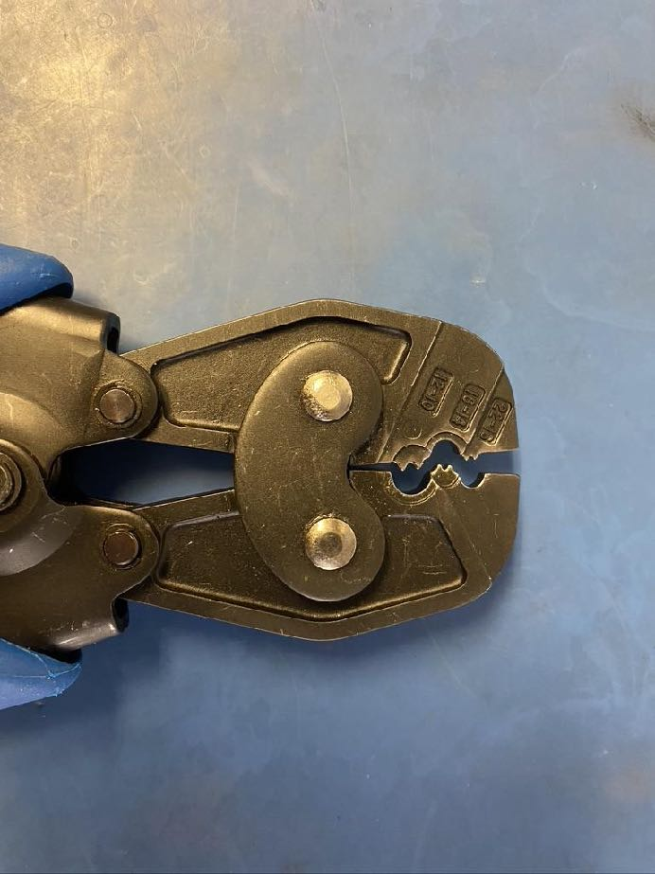
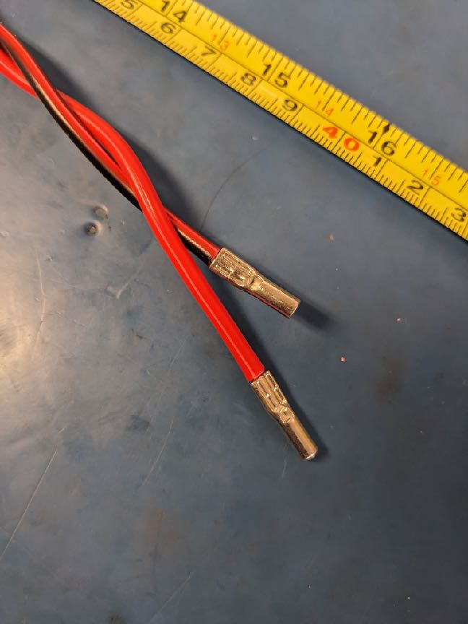
Crimp the terminals twice (two consecutive crimps next to one another as shown on the left) using the crimper’s 12-10 slot.

Slide 20
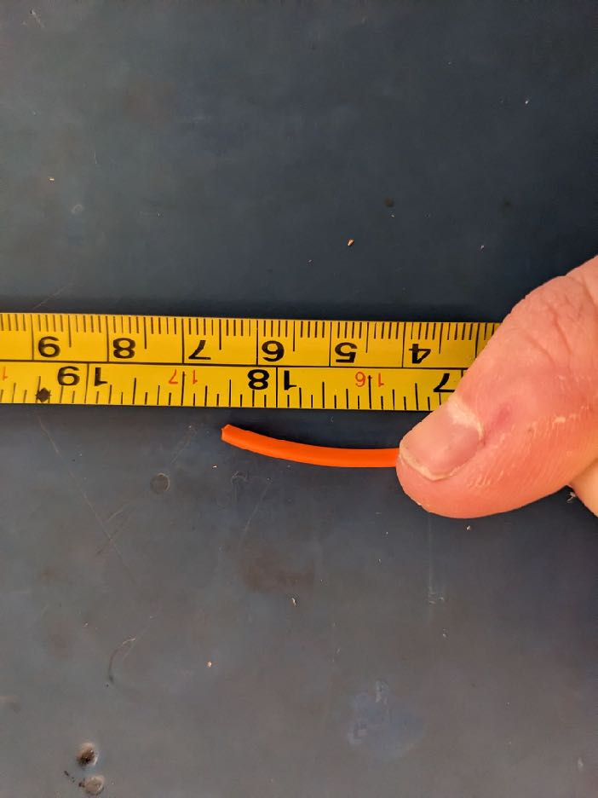
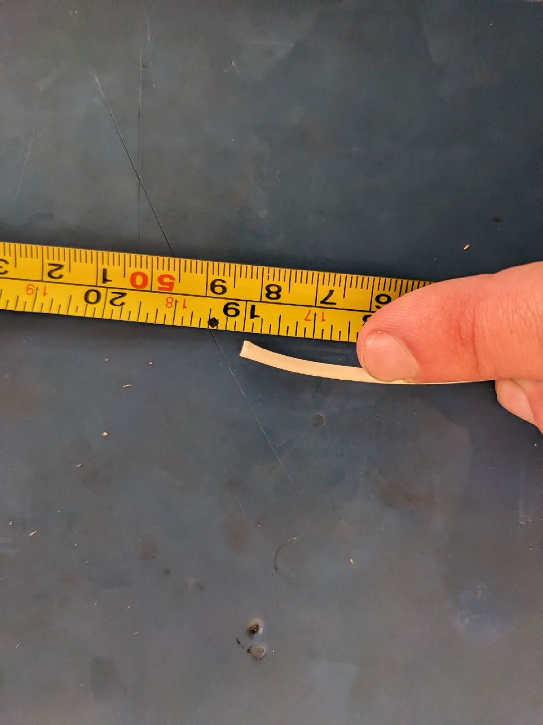
Measure out and cut 18.25 inches of orange and 19 inches of white 14 awg wire.

Slide 21
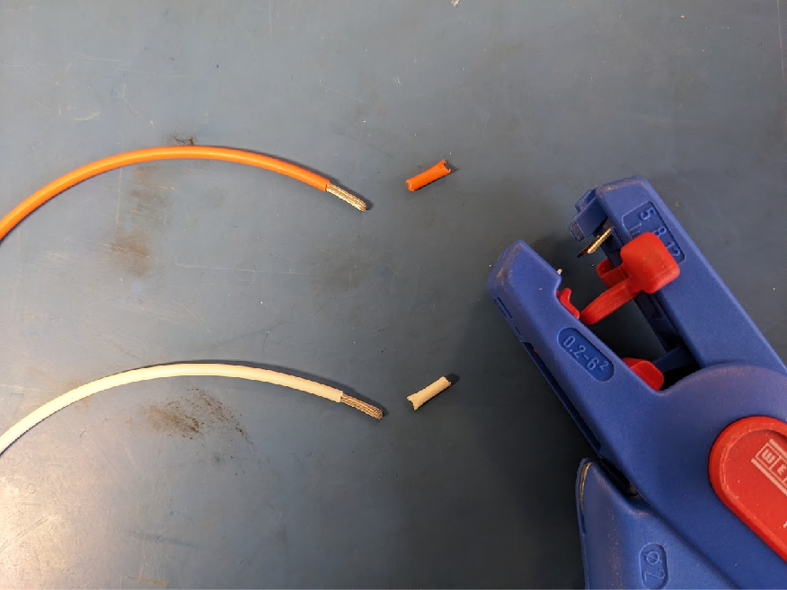
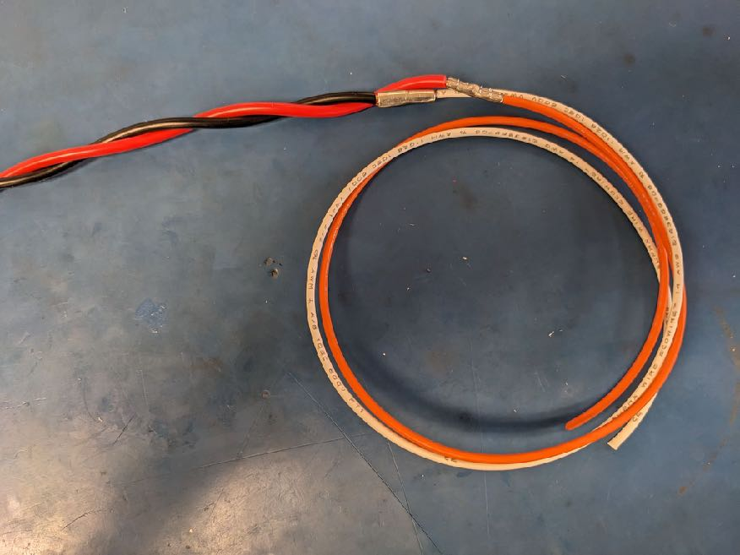
Remove 6 mm of isolation off of one end of each of the wires that were just cut.
Place those exposed ends into the other side of the 3M terminals and crimp the terminals twice again.
The black wire should be joined with the white wire. The red wire should be joined with the orange wire.

Slide 22
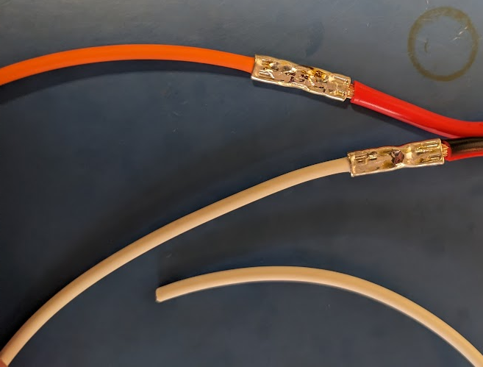
Solder the terminals. Try to put solder into the hole in the middle of the terminals so that solder can flow inside.

Slide 23
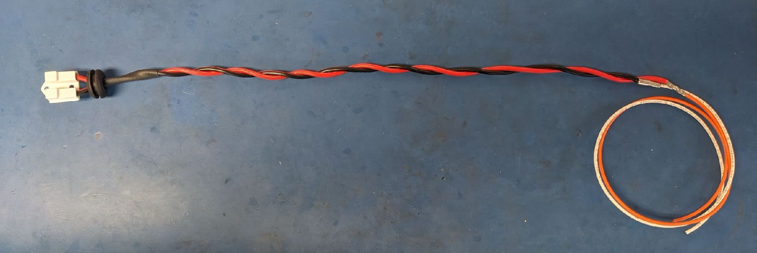
So far, the wire harness should appear as shown.
The combined length of the original red/black wires and the new orange/white extensions should be 34in

Slide 24
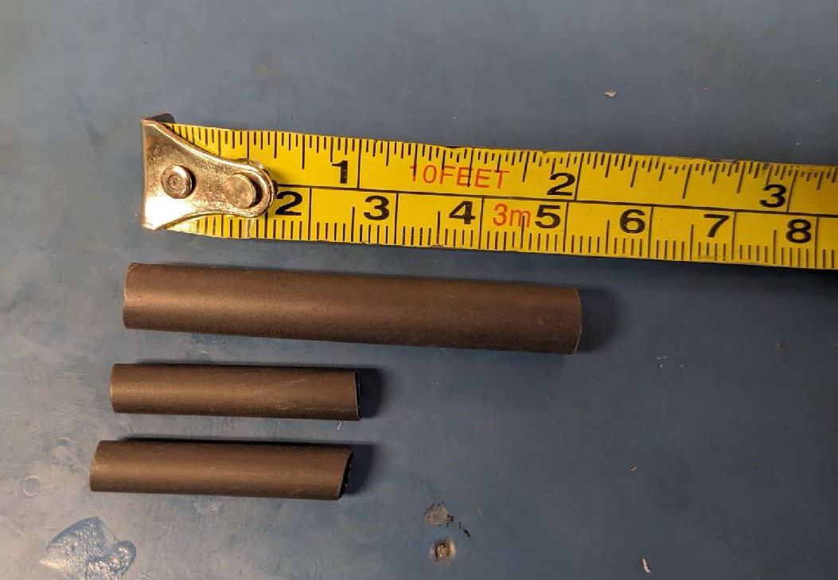
Measure out and cut two lengths of 4.8mm adhesive shrink tube each 1in long and one length of 6.4mm adhesive shrink tube 2in long.

Slide 25
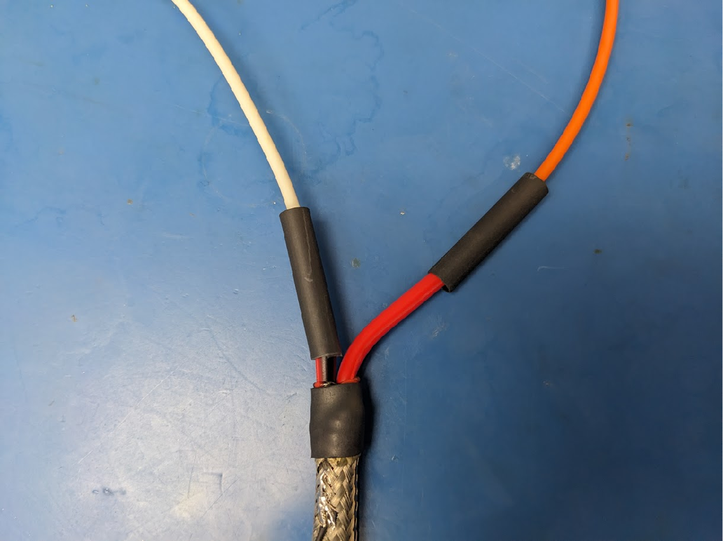
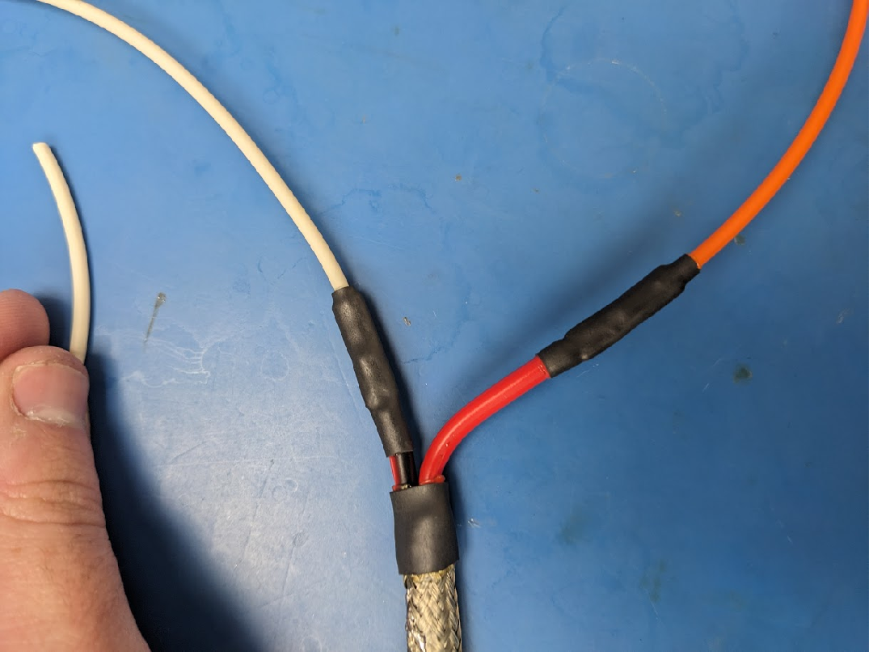
Place one length of the 4.8mm shrink tube on each wire to cover the terminals. Apply the heat gun.

Slide 26
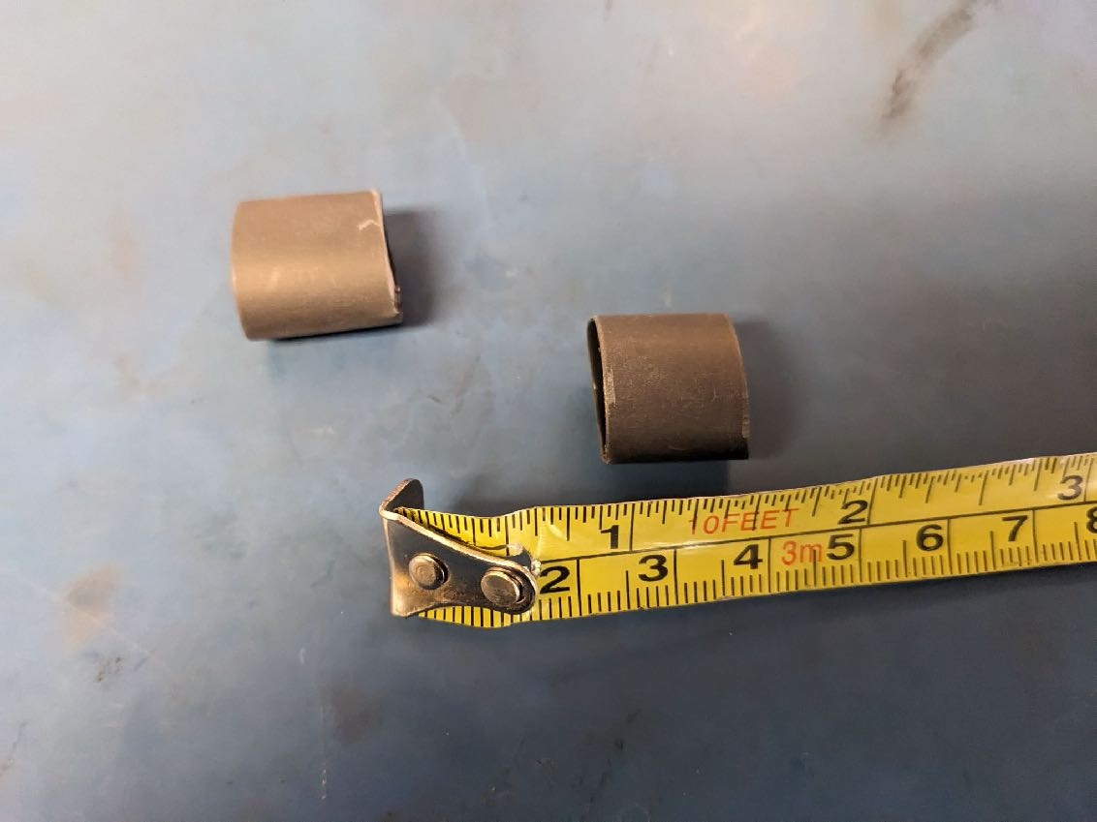
Measure out and cut two lengths of 12.7mm adhesive shrink tube each .5in long.

Slide 27
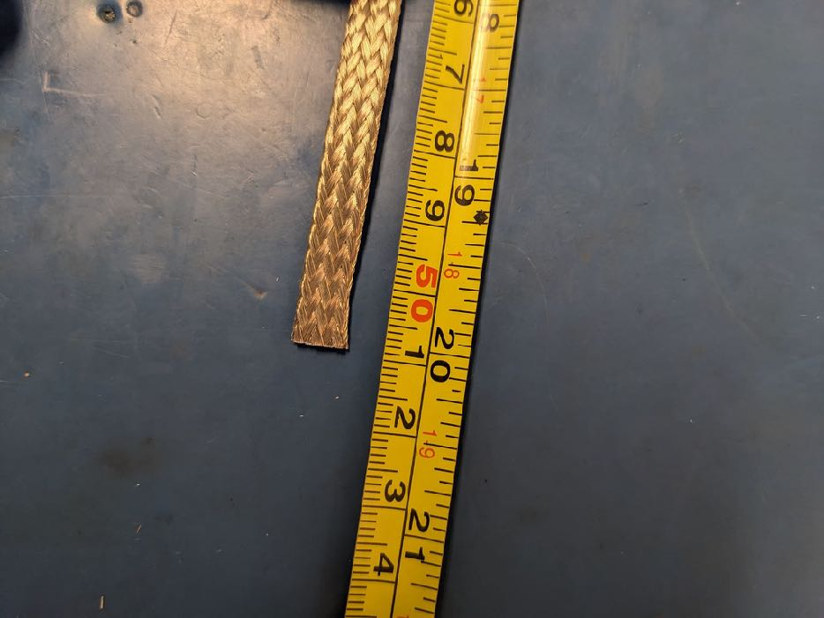
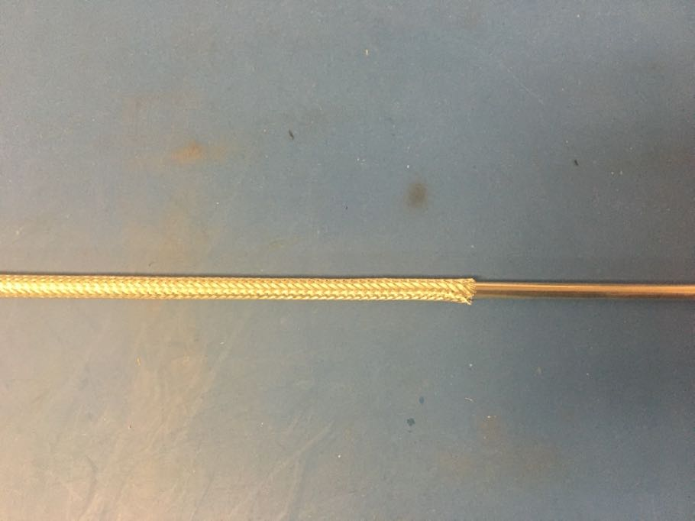
Measure out 20in inches of the .203 metal braid. Expand it using a metal rod or a long, thin screwdriver.

Slide 28
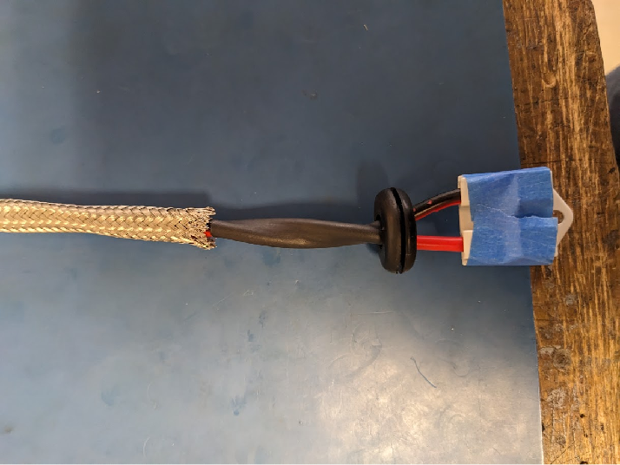
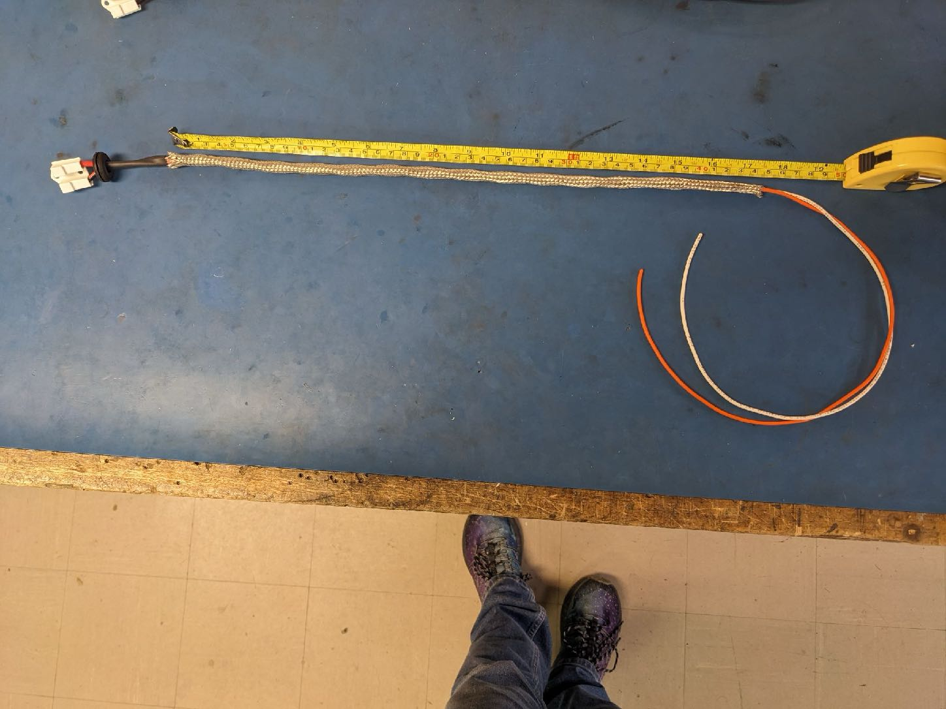
Put the metal braid onto the wire harness so that the end of the braid abuts the 2in heatshrink tubing. The stiff wire junctions should be covered by the braid.

Slide 29
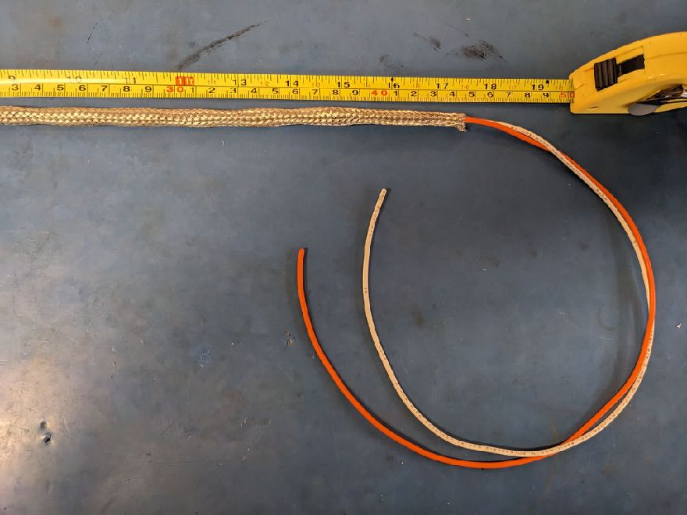
Note: as it expands in diameter, the braid will shrink slightly in length!
You should end up with about 17in of useable metal braid installed on the cable.

Slide 30
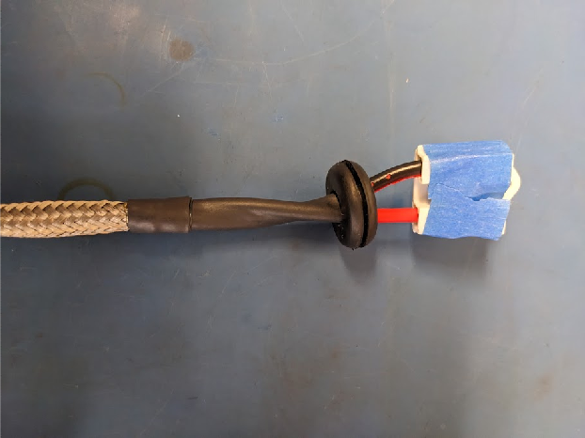
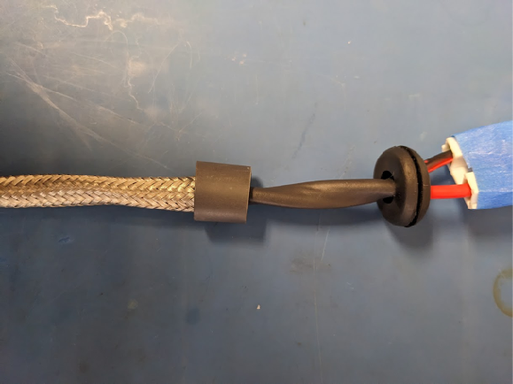
Place the pieces of 12.7mm shrink tube over the ends of the braid. Be sure that the braid ends midway through the pieces of shrink tube. Apply the heat gun to seal.

Slide 31
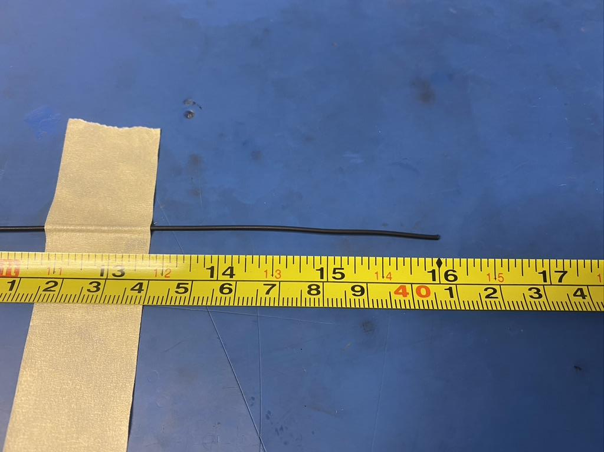
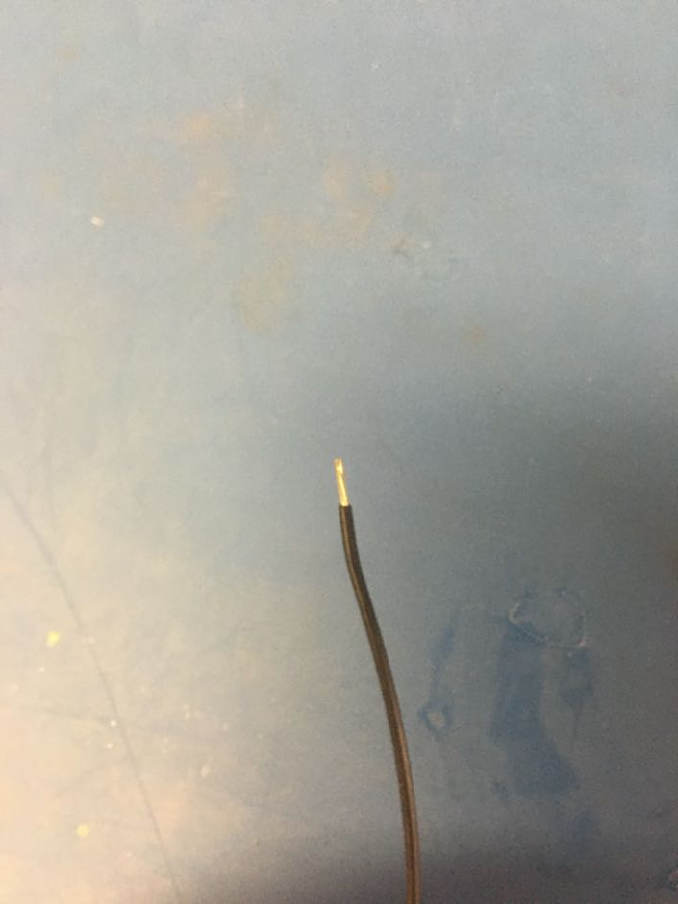
Measure out and cut 16 inches of black 24 awg wire. Strip 3-4mm off one end.

Slide 32
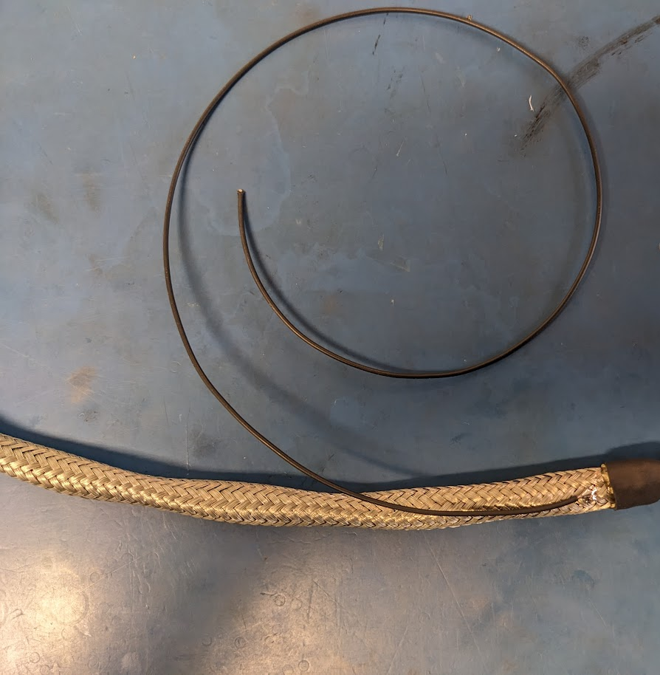
Solder the stripped end of the black wire onto the metal braid near the metal braid shrink tube joint furthest from the plug.
The black wire should be soldered so that its length runs with that of the metal braid.

Slide 33
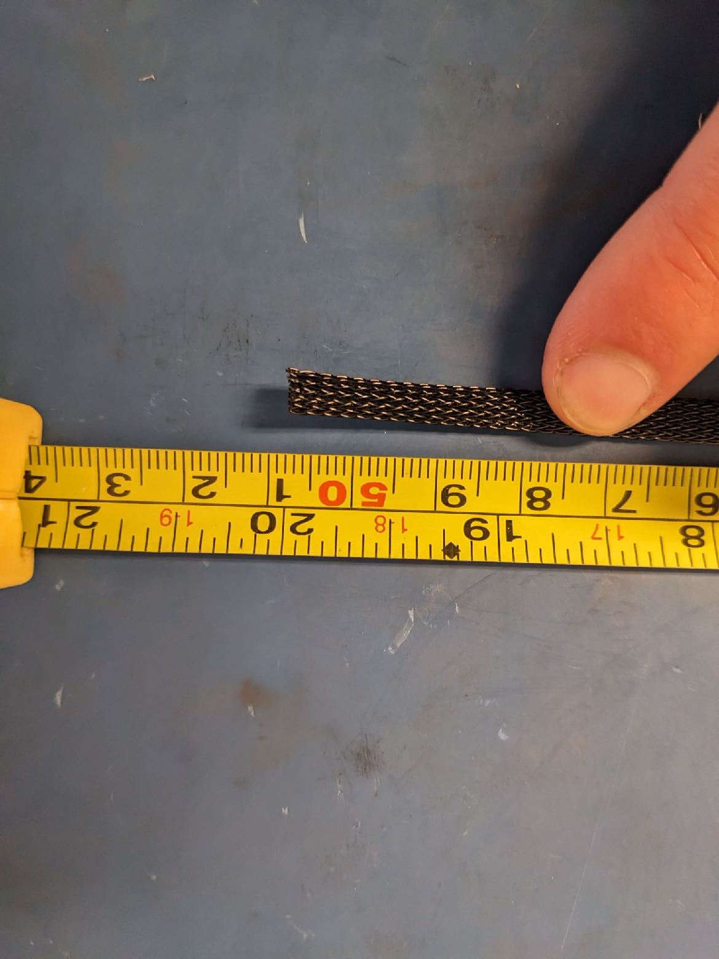
Measure out and cut 20-20.5 inches of 1/4th plastic braid.
As with the metal braid, the plastic braid will lose some length as it expands and as the ends fray slightly. Cutting 20.5in should give you enough usable length.

Slide 34
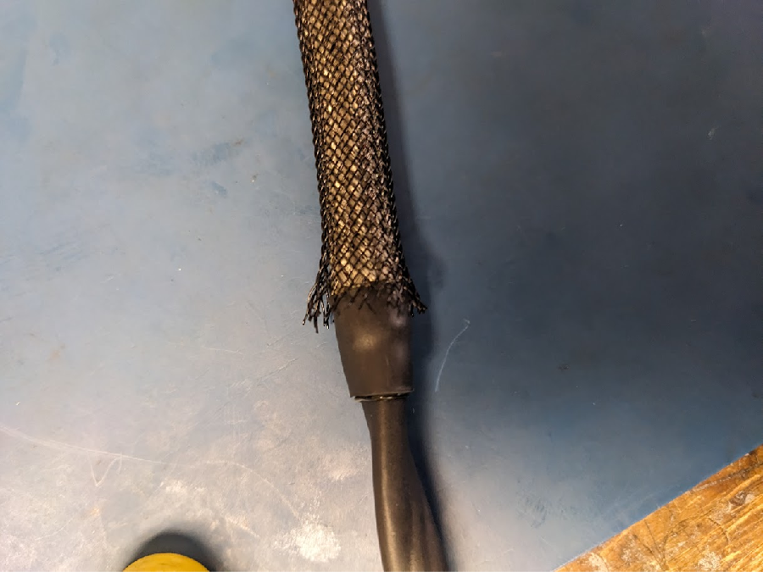
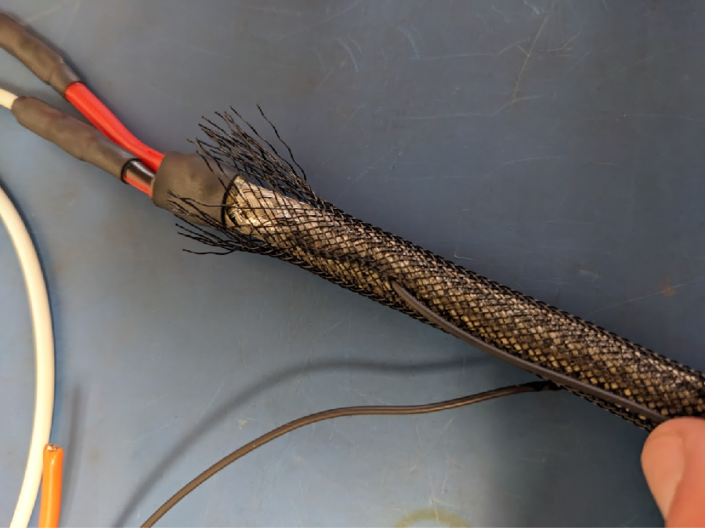
Put the plastic braid onto the wire harness. The end next to the plug should be just touching the end of heatshrink tubing as shown on the left.
On the other end, use tweezers to thread the ground wire through the plastic braid. The braid should end midway through the piece of shrink tube beneath it.

Slide 35
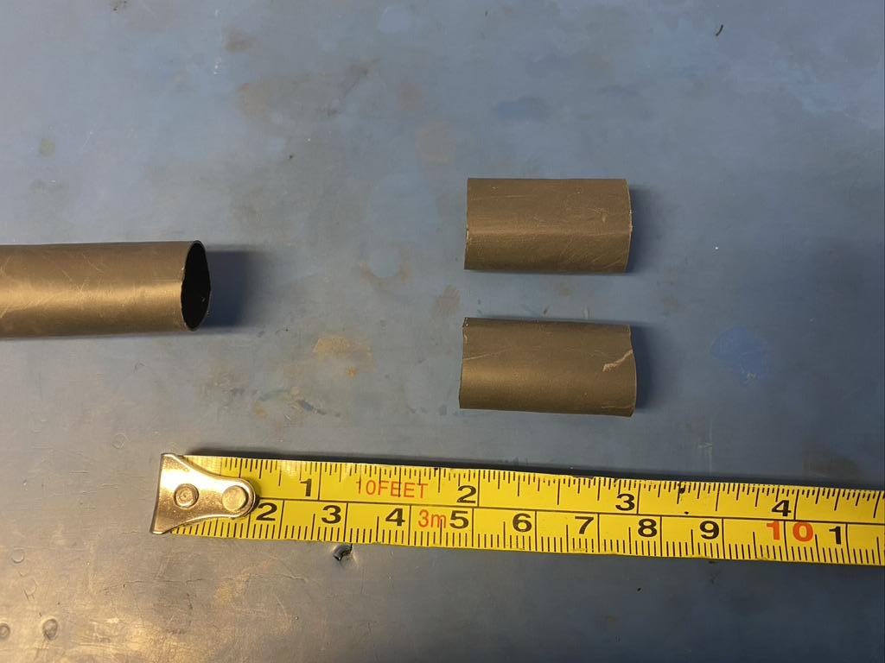
Measure out and cut two lengths of 12.7mm adhesive shrink tube each 1in long.

Slide 36
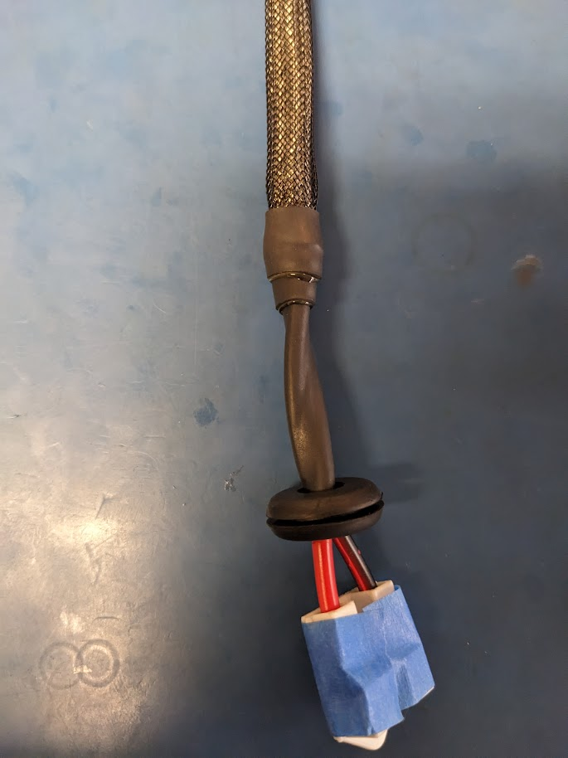
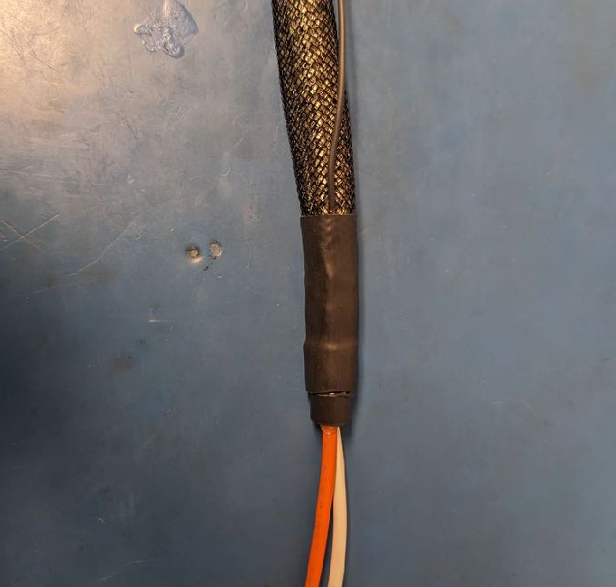
Take the second piece of shrink tube and put it on the remaining exposed end of the plastic braid. The shrink tube should be placed such that it covers the solder joint and the length of shrink tube beneath.
If the ends are very frayed or if the solder joint is not fully covered, apply more tubing.
Use the heat gun to seal
Take one piece of the shrink tube and put it on the plug and plastic braid joint.
Use the heat gun to seal.

Slide 37

Thus far, the harness should appear as shown.

Slide 38



Thread the wire extensions through the #75 magnet so that the magnet abuts the end of the heatshrink tubing, then loop them back through the bottom of the magnet as shown on the left. Pull the loops of wire taut so they appear as shown on the right. When pulling the loop of wire through, try to keep the wires parallel. Pull as tightly and securely as you can so that the profile of the wires on top of the magnets is as low as possible.
Note that there is NO easy way to tell #75 and #43 magnets apart. Keep the magnets in their separate bags or label them before installation.

Slide 39


Repeat the process shown on the previous slide with the second 43 magnet. Again, keep the wire profile as low as you can.

Slide 40


Place a piece of 1in long 6.4mm adhesive shrink tube such that it abuts the magnets. Apply the heat gun.
Place a piece of 1in long 12.7mm adhesive shrink tube on top of it. Apply the heat gun.
The stacking is necessary to create enough additional width for the final piece of heatshrink tubing to close around.

Slide 41

Measure out and cut one length of 19mm adhesive shrink tube that is 4.5in long.

Slide 42


Place the piece of 19mm shrink tube over the magnets so that roughly the same amount of shrink tube is visible coming out either end. Apply the heat gun.

Slide 43
Wire harness complete! The orange, white, and ground wire will be given tips later.

